Slide 1
Moving Forward:
Integrating Loss, Grief, and Bereavement into Daily Life

Slide 2
Part One: Understanding and integrating the experience of loss…
Essential Processes of Grief and Mourning
Living Loss and Communal Grief
Considerations for Integrating Loss
Understanding Loss
Distinguishing Complicated Grief from “Normal" Grief

Slide 3
Part Two: Tools, Resources, and Activities for the Journey Forward
Tools for Assessing and Supporting Oneself and Others
Writing Your Story: Accessing Personal Power through Narrative
Mindfulness and Other Supports
Discussion

Slide 4
Grief is a universal as well as a personal experience…it is the natural response to the loss of someone or something that is an essential part of one’s life.

Slide 5
What losses do we mourn?
Loss of a loved one: a beloved family member: a parent, a sibling, a child
Loss of a cherished friend or co-worker
Loss of a job or a home
Loss of the familiar: a routine, a way of life, the comfort of the predictable
Loss of a significant role or identity

Slide 6
All losses are significant
A loss is a loss
Many people minimize personal losses as: “I know others have lost more”
No judgement around the grief process
This Photo by Unknown Author is licensed under CC BY-NC-ND

Slide 7
Grief & Mourning are as unique to each person as their fingerprints…
Grief is a normal part of life: it is an organic process in response to loss
It is a personal experience: your own journey and response to loss
Grief is not an illness or a disability – it needs to be supported – but not “fixed”

Slide 8
Grief is a normal Response to a Loss. There is no Hierarchy of Loss! We grieve for all losses.
Primary Loss
Secondary Loss
Multiple Losses
Ambiguous Loss
Stigmatized Loss
Zhai, Yusen, and Xue Du. “Loss and grief amidst COVID-19: A path to adaptation and resilience.” Brain, behavior, and immunity vol. 87 (2020): 80-81. doi:10.1016/j.bbi.2020.04.053
This Photo by Unknown Author is licensed under CC BY-NC-ND

Slide 9
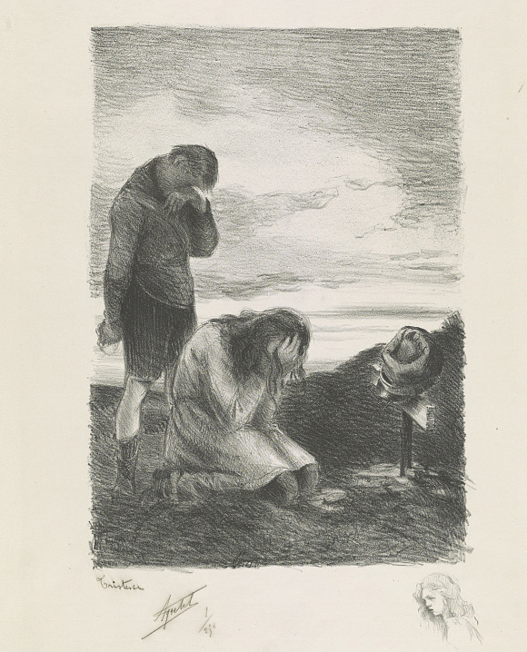
Primary Loss
Death of a loved one, someone who has been an integral part of one’s life: death of a spouse, a parent, a child
Results in a major life change: a wife becomes a widow, a husband becomes a widower, a daughter/son becomes an “orphan”
We consider it “reasonable” to mourn this kind of loss: we don’t tend to judge ourselves or others for engaging in the grief process
Zhai, Yusen, and Xue Du. “Loss and grief amidst COVID-19: A path to adaptation and resilience.” Brain, behavior, and immunity vol. 87 (2020): 80-81. doi:10.1016/j.bbi.2020.04.053
This Photo by Unknown Author is licensed under CC BY-SA-NC

Slide 10
Secondary Loss
Secondary losses evolve from the primary loss. There is grief over the primary loss as well as grief as the result of
loss of companionship
loss of identity as a wife, sibling, parent & the activities that are a part of this role
loss of a sexual relationship
loss of a role in the community
Zhai, Yusen, and Xue Du. “Loss and grief amidst COVID-19: A path to adaptation and resilience.” Brain, behavior, and immunity vol. 87 (2020): 80-81. doi:10.1016/j.bbi.2020.04.053

Slide 11
Multiple Losses
Multiple losses are connected to each other or occur within a short period of time: losing friends and family members during a natural disaster such as a storm, earthquake, or the COVID-19 pandemic
Loss of a personal capability or role that creates disconnection from social contacts, physical activities, daily routines (examples: loss of a job, sudden physical impairment, COVID-19 pandemic)
Multiple losses have the potential to create ”Bereavement Overload” – compassion fatigue, burn-out, increased alcohol & substance use
Zhai, Yusen, and Xue Du. “Loss and grief amidst COVID-19: A path to adaptation and resilience.” Brain, behavior, and immunity vol. 87 (2020): 80-81. doi:10.1016/j.bbi.2020.04.053
This Photo by Unknown Author is licensed under CC BY-ND

Slide 12
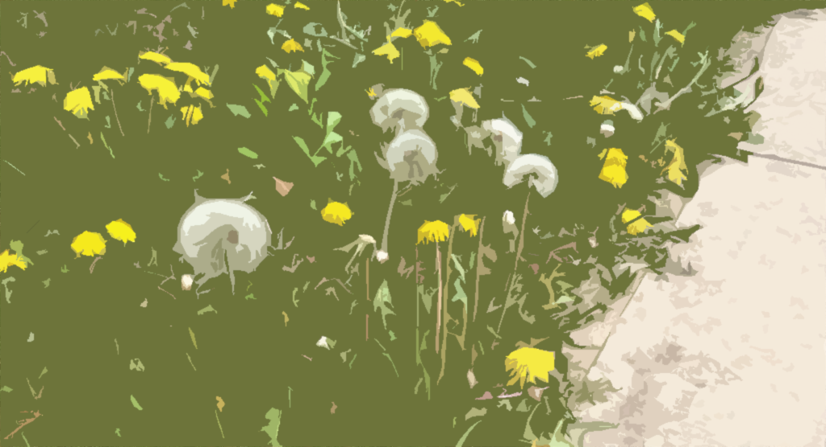
Ambinvalent Loss
Experienced frequently during the COVID-19 pandemic
Nurses/doctors/caregivers often needed to self-quarantine from family to avoid making them sick: loss of physical contact despite continued psychological connection
Stigmatized loss: being blamed for contracting/transmitting illness leads to alienation and loss of support networks
This Photo by Unknown Author is licensed under CC BY
Zhai, Yusen, and Xue Du. “Loss and grief amidst COVID-19: A path to adaptation and resilience.” Brain, behavior, and immunity vol. 87 (2020): 80-81. doi:10.1016/j.bbi.2020.04.053

Slide 13
Stages of Grief – Elisabeth Kübler-Ross (1969)
Denial
Anger
Bargaining
Depression/Despair
Acceptance

Slide 14
What is the “Normal” Process of Moving through these Stages?
Stages of Grief are not linear -- do not need to be experienced as a sequence
Grief is part of the human experience, not an illness. One doesn’t “recover” from grief because the loss is forever
Each stage may be iterative – experienced again and again in the process of learning and understanding

Slide 15
Denial
Inability to accept what has occurred: unable to grasp that the world has changed, a prevailing sense of disorientation and disbelief
Process of absorbing and understanding what has happened … mind tries to slow down the recognition/awareness of what has occurred so that it does not become overwhelmed
Things seem unreal and confused
Not a pathological process!
This Photo by Unknown Author is licensed under CC BY-NC-ND

Slide 16
Anger
An effort to regain a sense of control over one’s world – to identify who/what is responsible & understand why the loss has occurred
A way to mitigate/manage feelings like sadness, vulnerability, and powerlessness
Anger can provide a structure for managing more overpowering feelings
May be characterized by outbursts, behavior that is aggressive and harmful to self or others
This Photo by Unknown Author is licensed under CC BY

Slide 17
Bargaining
Adjunct effort to re-establishing a sense of autonomy and control
The mind attempts to alter the outcome of the loss; thoughts of “If only…what if” are common
Bargaining is often accompanied by feelings of guilt: obsessively seeking things that could have been done better or differently to create a different outcome
Guilt is a frequent partner in this process
This Photo by Unknown Author is licensed under CC BY

Slide 18
Depression
This Photo by Unknown Author is licensed under CC BY-NC-ND
An essential part of the natural evolution of the grief process
Feelings of hopelessness, even despair common
Reduced energy, low motivation
Sadness, crying, lack of interest in everyday activities
Not pathological or a sign of mental illness: what has happened is sad and depression is a normal, expected response: it’s how the mind processes and integrates what has happened

Slide 19
Acceptance
Final stage in the Kübler-Ross Model
Beginning to live within the context of the “new normal”
Being mindful, living in the moment, engaging with reality
There may be more “good days” than “bad days”
This Photo by Unknown Author is licensed under CC BY
Source: https://www.washington.edu/counseling/2020/06/08/the-stages-of-grief-accepting-the-unacceptable/

Slide 20
Complicated Grief
Also called Persistent Complex Bereavement Disorder
A matter of degree: normal grief process seems to stall, person continues to struggle intensely
Ability to function in normal routines, work, or with friends and others is impaired
Sadness is overwhelming, deep depression and/or guilt may be present
Person may have concrete suicidal thoughts
Seeking professional help through counseling and therapy indicated
Source: https://www.mayoclinic.org/diseases-conditions/complicated-grief/symptoms-causes/syc-20360374
This Photo by Unknown Author is licensed under CC BY-ND

Slide 21
Grief and the COVID-19 pandemic
An experience of “collective grief” – everyone is losing something
Loss of loved ones is complicated by inability to be near them during their illness and the absence of typical rituals of mourning
Loss of confidence in systems we believed were stable and reliable: health care, education, even government
Many losses are ambiguous-- hard to name or define, there is a communal sense of loss as our once-predictable way of life dissolves
Weir, Kirsten. Grieving Life and Loss. American Psychological Association, Vol 4., June 2021

Slide 22
Languishing: not grief but something else
Adam Grant, organizational psychologist at Wharton calls languishing “the neglected middle child of mental health”
Perhaps the most prevalent emotion of 2021
A sense of stagnation and emptiness
Mental fogginess – difficulty concentrating, feeling aimless
The “absence of well-being”
2020 evidence from Italy indicates that individuals who languish may be at greater risk for developing PTSD
This Photo by Unknown Author is licensed under CC BY-NC-ND

Slide 23
Finding Meaning: Moving Forward
David Kessler: Finding Meaning: the final step in the Grief Process
Tools for Finding Meaning
Naming what has happened: a way to understand the experience
Writing about the experience, developing a grief journal
Mindfulness Meditation and Mindfulness Based Stress Reduction
Supporting each other: assessing for and responding to Complicated Grief
Support groups and other options for sharing experiences of loss
This Photo by Unknown Author is licensed under CC BY-ND

Slide 24
Part Two: July 29, 2021 Tools, Resources & Actvities for the Journey Forward

